Slide 1

Introduction to Software Engineering
Zarin Hadika

Slide 2
What is SWE??
Software is considered to be collection of executable programming code, associated libraries and documentations.
Software, when made for a specific requirement is called software product.
Engineering on the other hand, is all about developing products, using well defined, scientific principles and methods.
Software engineering is an engineering branch associated with development of software product using well-defined scientific principles, methods and procedures.

Slide 3
Outcome
The outcome of software engineering is a large, scalable, cost effective, efficient and reliable software product.

Slide 4
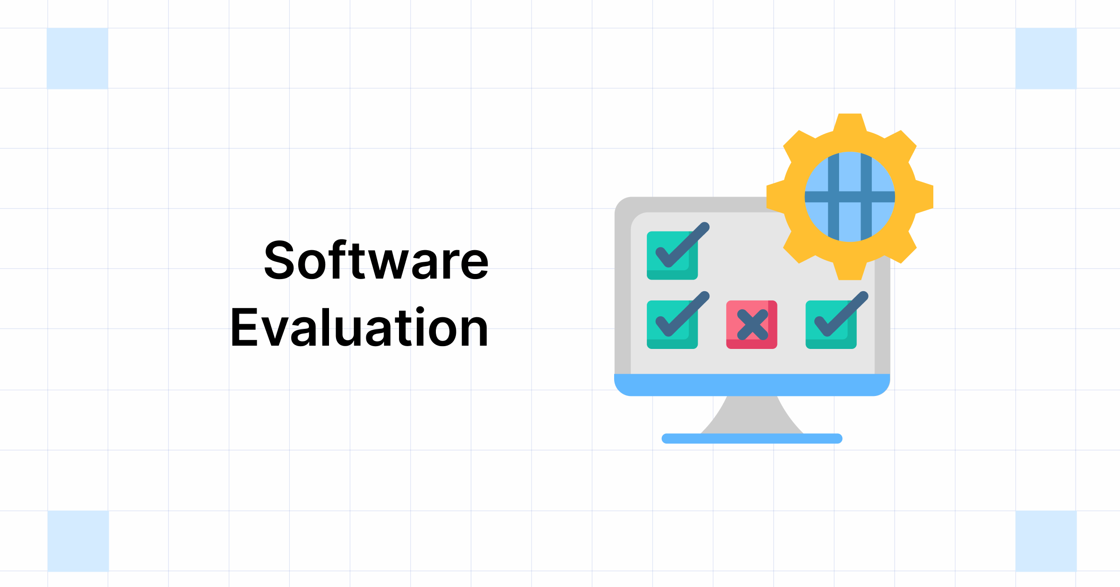
The process of developing a software product using software engineering principles and methods is referred to as Software Evolution.
This includes the initial development of software and its maintenance and updates, till desired software product is developed, which satisfies the expected requirements.

Slide 5
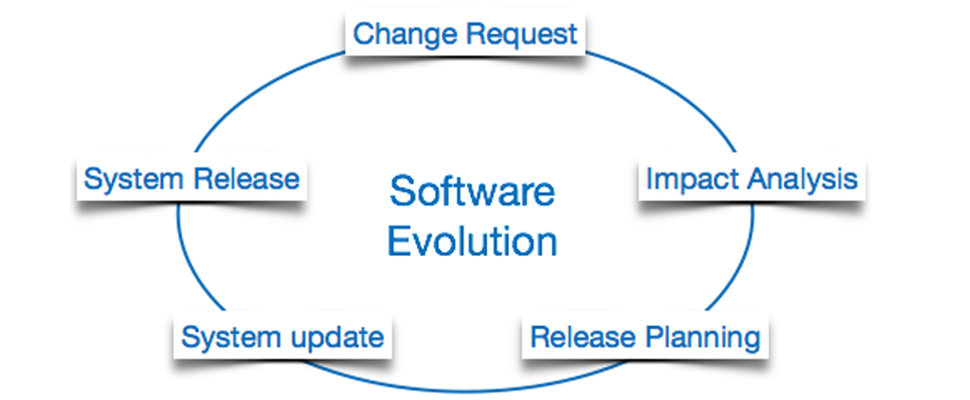
Steps of software Evaluation

Slide 6
Description on Software Evaluation
The users suggest changes, on which several consecutive updates and maintenance keep on changing too.
This process changes to the original software, till the desired software is accomplished.
Even after the user has the desired software in hand, the advancing technology and the changing requirements force the software product to change accordingly.
Re-creating software from scratch and to go one-on-one with the requirement is not feasible.
The only feasible and economical solution is to update the existing software so that it matches the latest requirements.

Slide 7

Lehman’s Law

Slide 8
Lehman has given laws for software evolution. He divided the software into three different categories:
1. Static-type (S-type) - This is a software, which works strictly according to defined specifications and solutions. The s-type software is least subjected to changes hence this is the simplest of all. For example, calculator program for mathematical computation.
2. Practical-type (P-type) - This is a software with a collection of procedures. In this software, the specifications can be described but the solution is not obviously instant. For example, gaming software.
3. Embedded-type (E-type) - This software works closely as the requirement of real-world environment. This software has a high degree of evolution as there are various changes in laws, taxes etc. in the real-world situations. For example, Online trading software.

Slide 9
Lehman has also given eight laws for E-type software evaluation
Continuing Change
Increasing Complexity
Conservation of familiarity
Continuing Growth
Reducing Quality
Feedback Systems
Self Regulation
Organizational Stability

Slide 10
Software Development Life Cycle
Software Development Life Cycle, SDLC for short, is a well-defined, structured sequence of stages in software engineering to develop the intended software product.

Slide 11
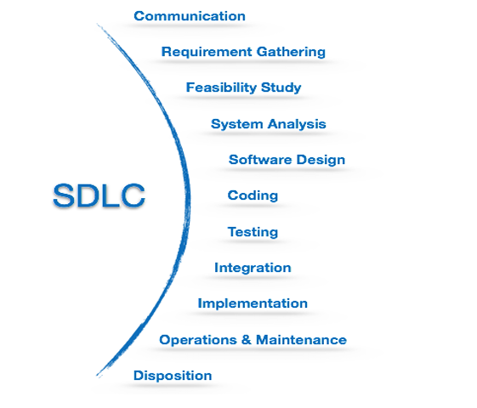
Steps of SDLC

Slide 12
A few of software development paradigms or process models are defined as follows:
Waterfall Model
Iterative Model
V-Model
Spiral Model
Big-Bang Model
Agile Model
Prototype Model
Rapid Application Development Model

Slide 13
Big-Bang Model
This model is the simplest model in its form.
It requires little planning, lots of programming and lots of funds.
This model is conceptualized around the big bang of universe.
Likewise, if we put together lots of programming and funds, you may achieve the best software product.
For this model, very small amount of planning is required.
It does not follow any process, or at times the customer is not sure about the requirements and future needs. So, the input requirements are arbitrary.
This model is not suitable for large software projects but good one for learning and experimenting.

Slide 14
